Slide 1
Smart Crop recommendation System

Slide 2
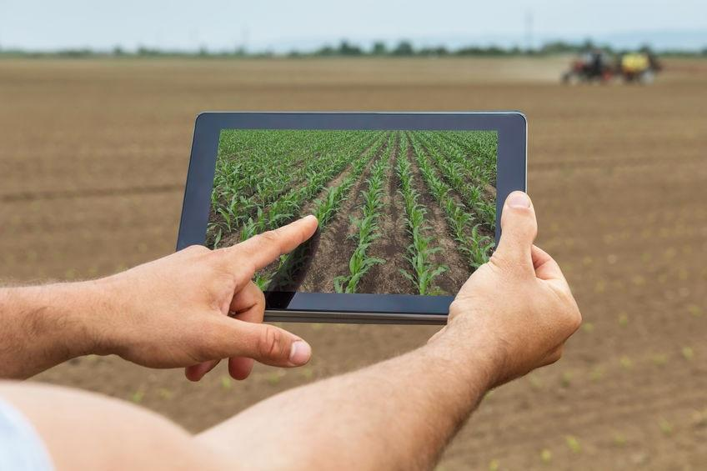
CONTENTS
Introduction
Problem
Solution
Working
Graph and technology used
Show stopper
Conclusion

Slide 3
INTRODUCTION
Crop recommendation means the suggestion of suitable crop by sensing various parameters of soil which include type of soil, PH, Nitrogen, Phosphate, etc and also some atmosphere related parameters such as rainfall, temperature, humidity and sunshine hours.

Slide 4
Most of the times farmers don’t know that which crop is most suitable for growing in their field and they end up choosing the wrong one which causes so much loss to them and results in crops of less nutritional value.
Problem

Slide 5
Solution
We focus on building an AI-based machine that will help us to recommend the type of crop that must be grown in the particular soil and weather conditions. The machine will help us in predicting the exact type of crop so in this way the maximum amount of crop will be yield in the best possible time and the farmer doesn't need to worry about the type of crop he must grow. With this machine, the exact details of the crop must be suggested and after every change in season, the farmers will get the best possible set of crops that he can grow. Eventually, it will result in maximum crop production and that at a faster pace.

Slide 6
Working
We aim in designing a CROP RECOMMENDATION application that will help the farmer in selecting the best possible crops for their fields. For this, we will be designing an android application. The farmer will go to our android application and give the required input while some inputs will be taken by the application itself by using the geolocation. Now after getting the required input the application will send all the data to the cloud. The cloud will analyze the data and our machine learning model will understand the field requirement. Based on that cloud will send the complete result to the application. Our mobile application will calculate and study the crop and will let the farmer know which is the most suitable crop that he must grow on his field.

Slide 7




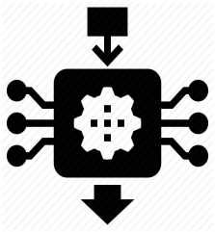



Workflow diagram
Now our AI model predict the crop good for that field and send data to app.
Firstly, farmer open our android app and input some data then click submit button.
Then app transfer all data to our cloud where our AI model is deploy.
APP display data to farmer in 2 min. (Approx)

Slide 8
Technology Used
1
Android Application
2
ML Model
K-means
Naive bayes
3
Microsoft Azure Cloud
4
Firebase

Slide 9
Conclusion
Nowadays farmers facing lots of problems and they don't know the proper information regarding crops to grow. This AI-based crop recommendation Application helps farmers to know the right crop to grow. This Application predicts the crops using field data based on the climatic conditions.
This system also useful to agriculture departments to predicts the right crop at right time. If we have such kind of automation, it will be useful to farmers and the agricultural field. The goals are to reduced manual work and provide a smooth workflow in the field of farming.

Slide 10
Thank you

